Slide 1
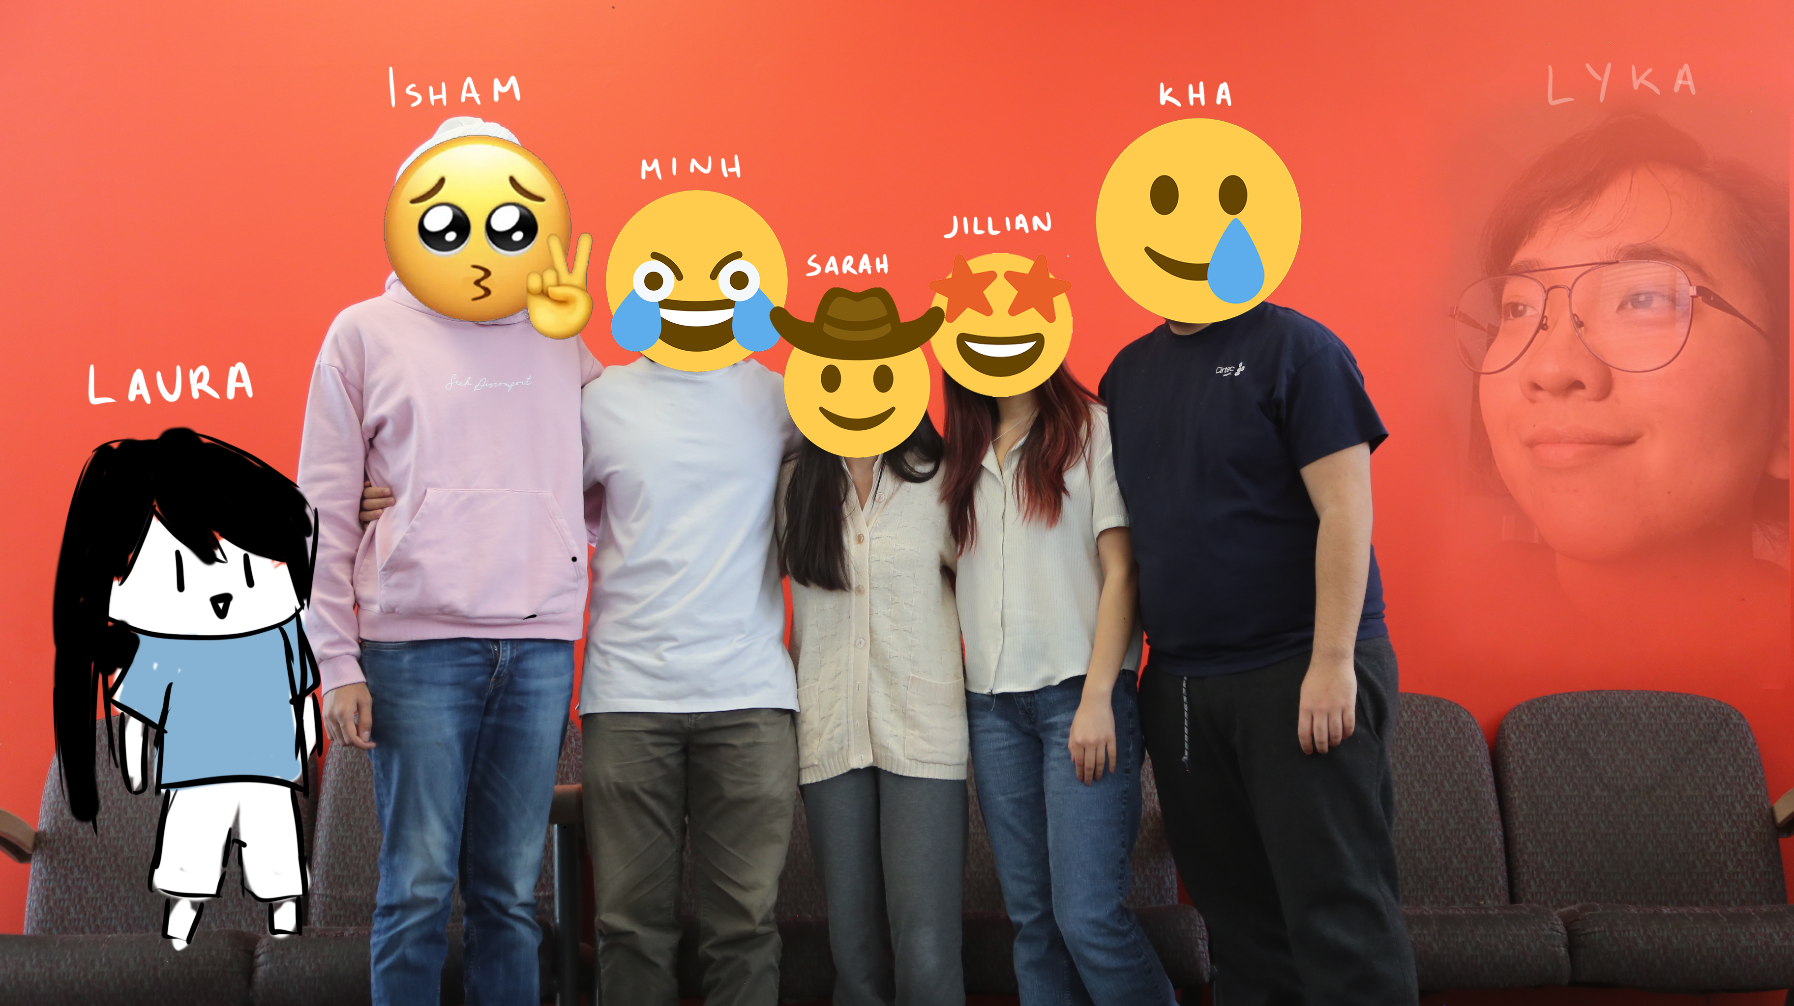
Costco Parking Simulator: Finding Spaces at Costco
Team: Ctrl + Alt + DELETE

Slide 2
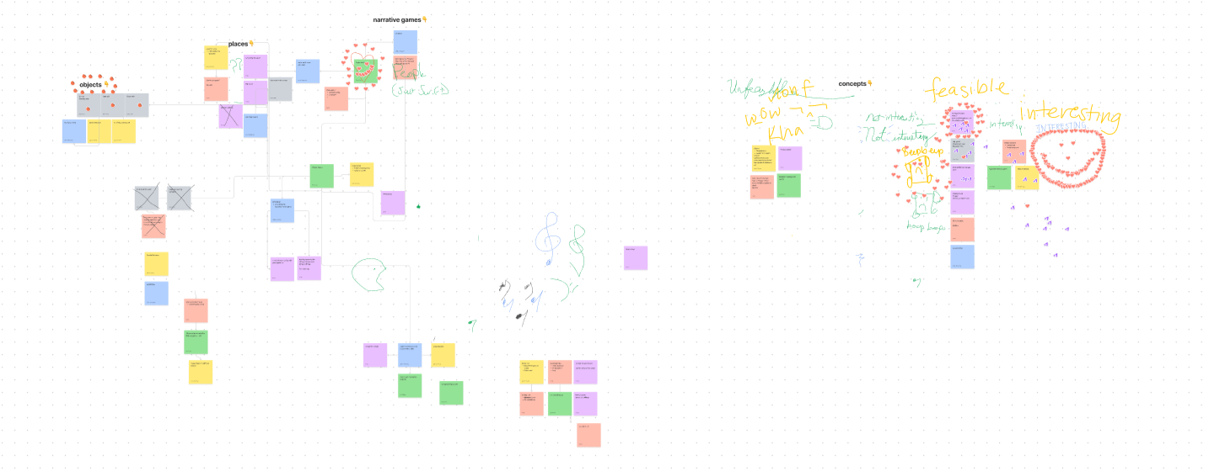
Brainstorming: Figjam

Slide 3
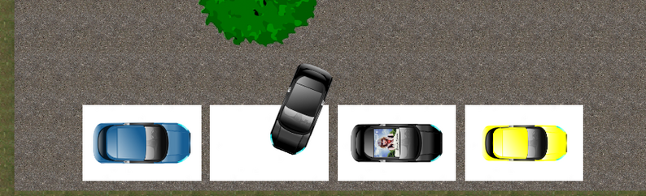
Assets
All the art, sounds and gameplay was done during the jam by our team. We borrowed some assets from the unity store to get a template of how to make the assets and edited them with photoshop.
Lyka made the music using only her voice! :D

Slide 4
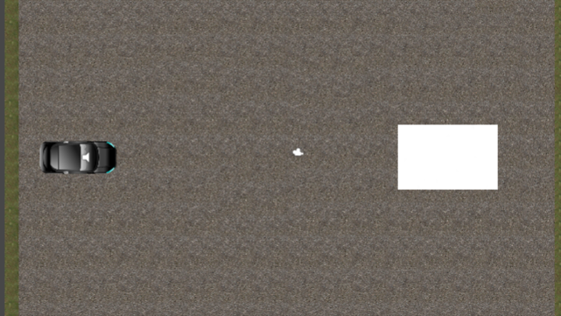
Theme: Space
Game Idea: Inspired by Parking Mania
Costco Parking Simulator!
Finding Spaces at Costco

Slide 5
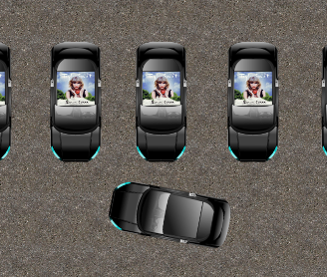
You and your friends are at a game jam and you got the munchies. So you head to Costco, but OH NO there's no space for parking. Now you have to drive around and find parking spaces without getting any dents on Kha's car!
Dodge the shopping carts, and other vehicles (mostly taylor swift). But, you might get extra points for hitting J-walking Karens. They will be in tighter spots and you'll have to go out of your way to not get the manager called!
Don't wait too long because than you won't make it in time for the jam and the opening ceremony starts in 15 minutes!

Slide 6
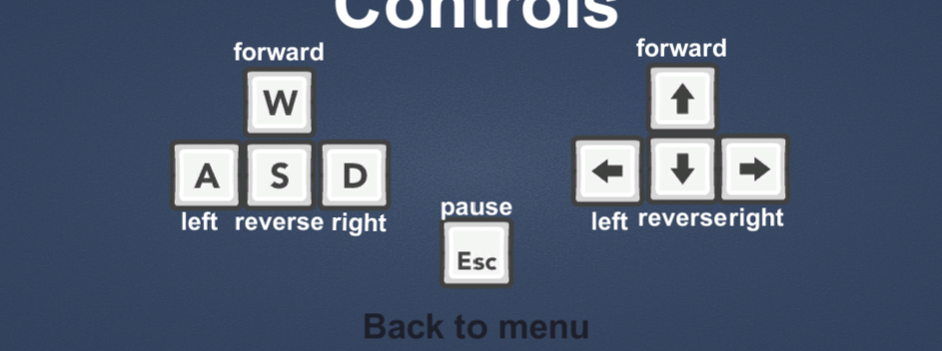
Use WASD or the arrow keys to steer and drive the car forward and backward. The goal is to park the car in the parking space. Just don't crash into anything! Good Luck! (:

Slide 7
DEMO TIME https://marshmallows7920.itch.io/costco-parking-simulator

Slide 8
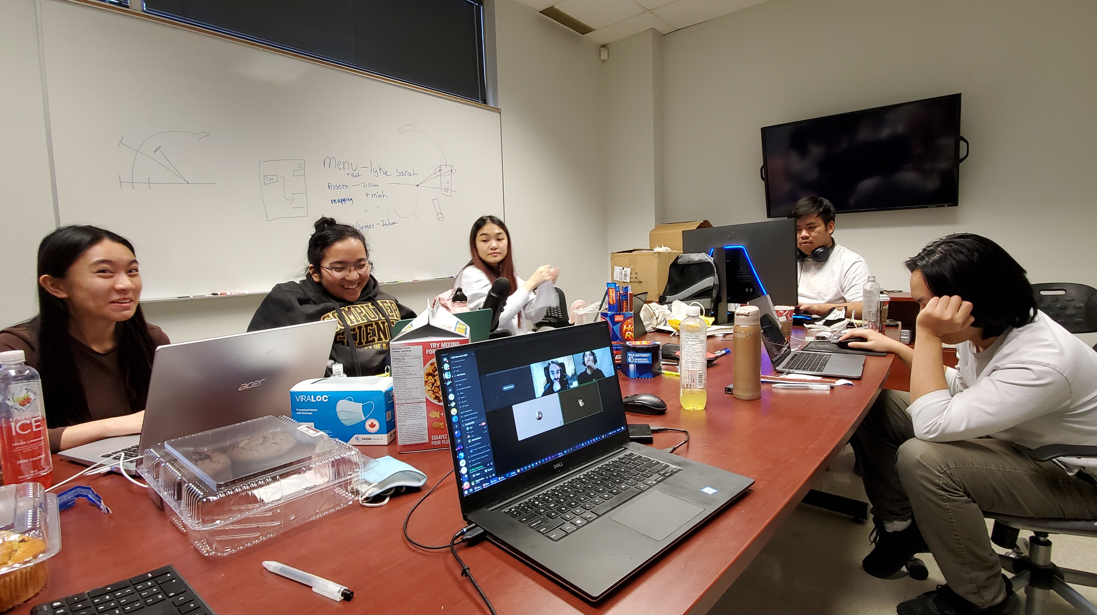
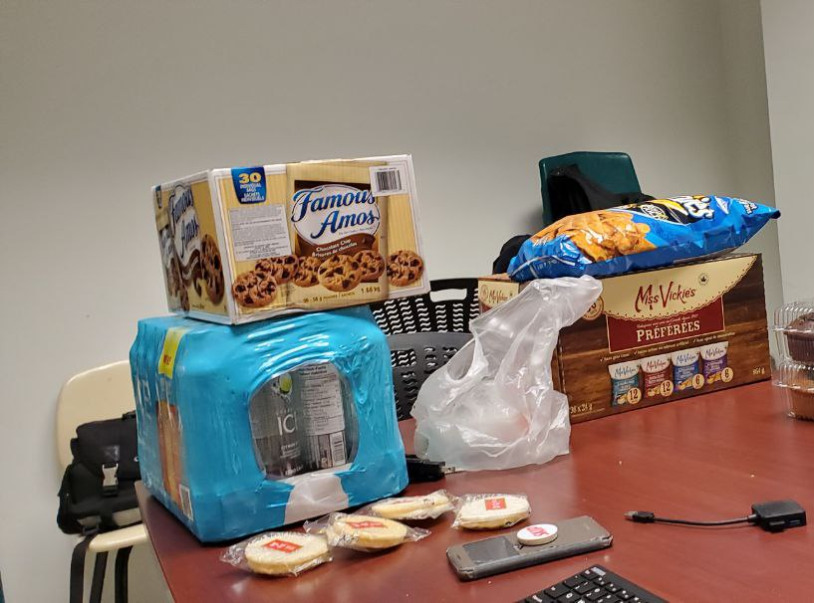
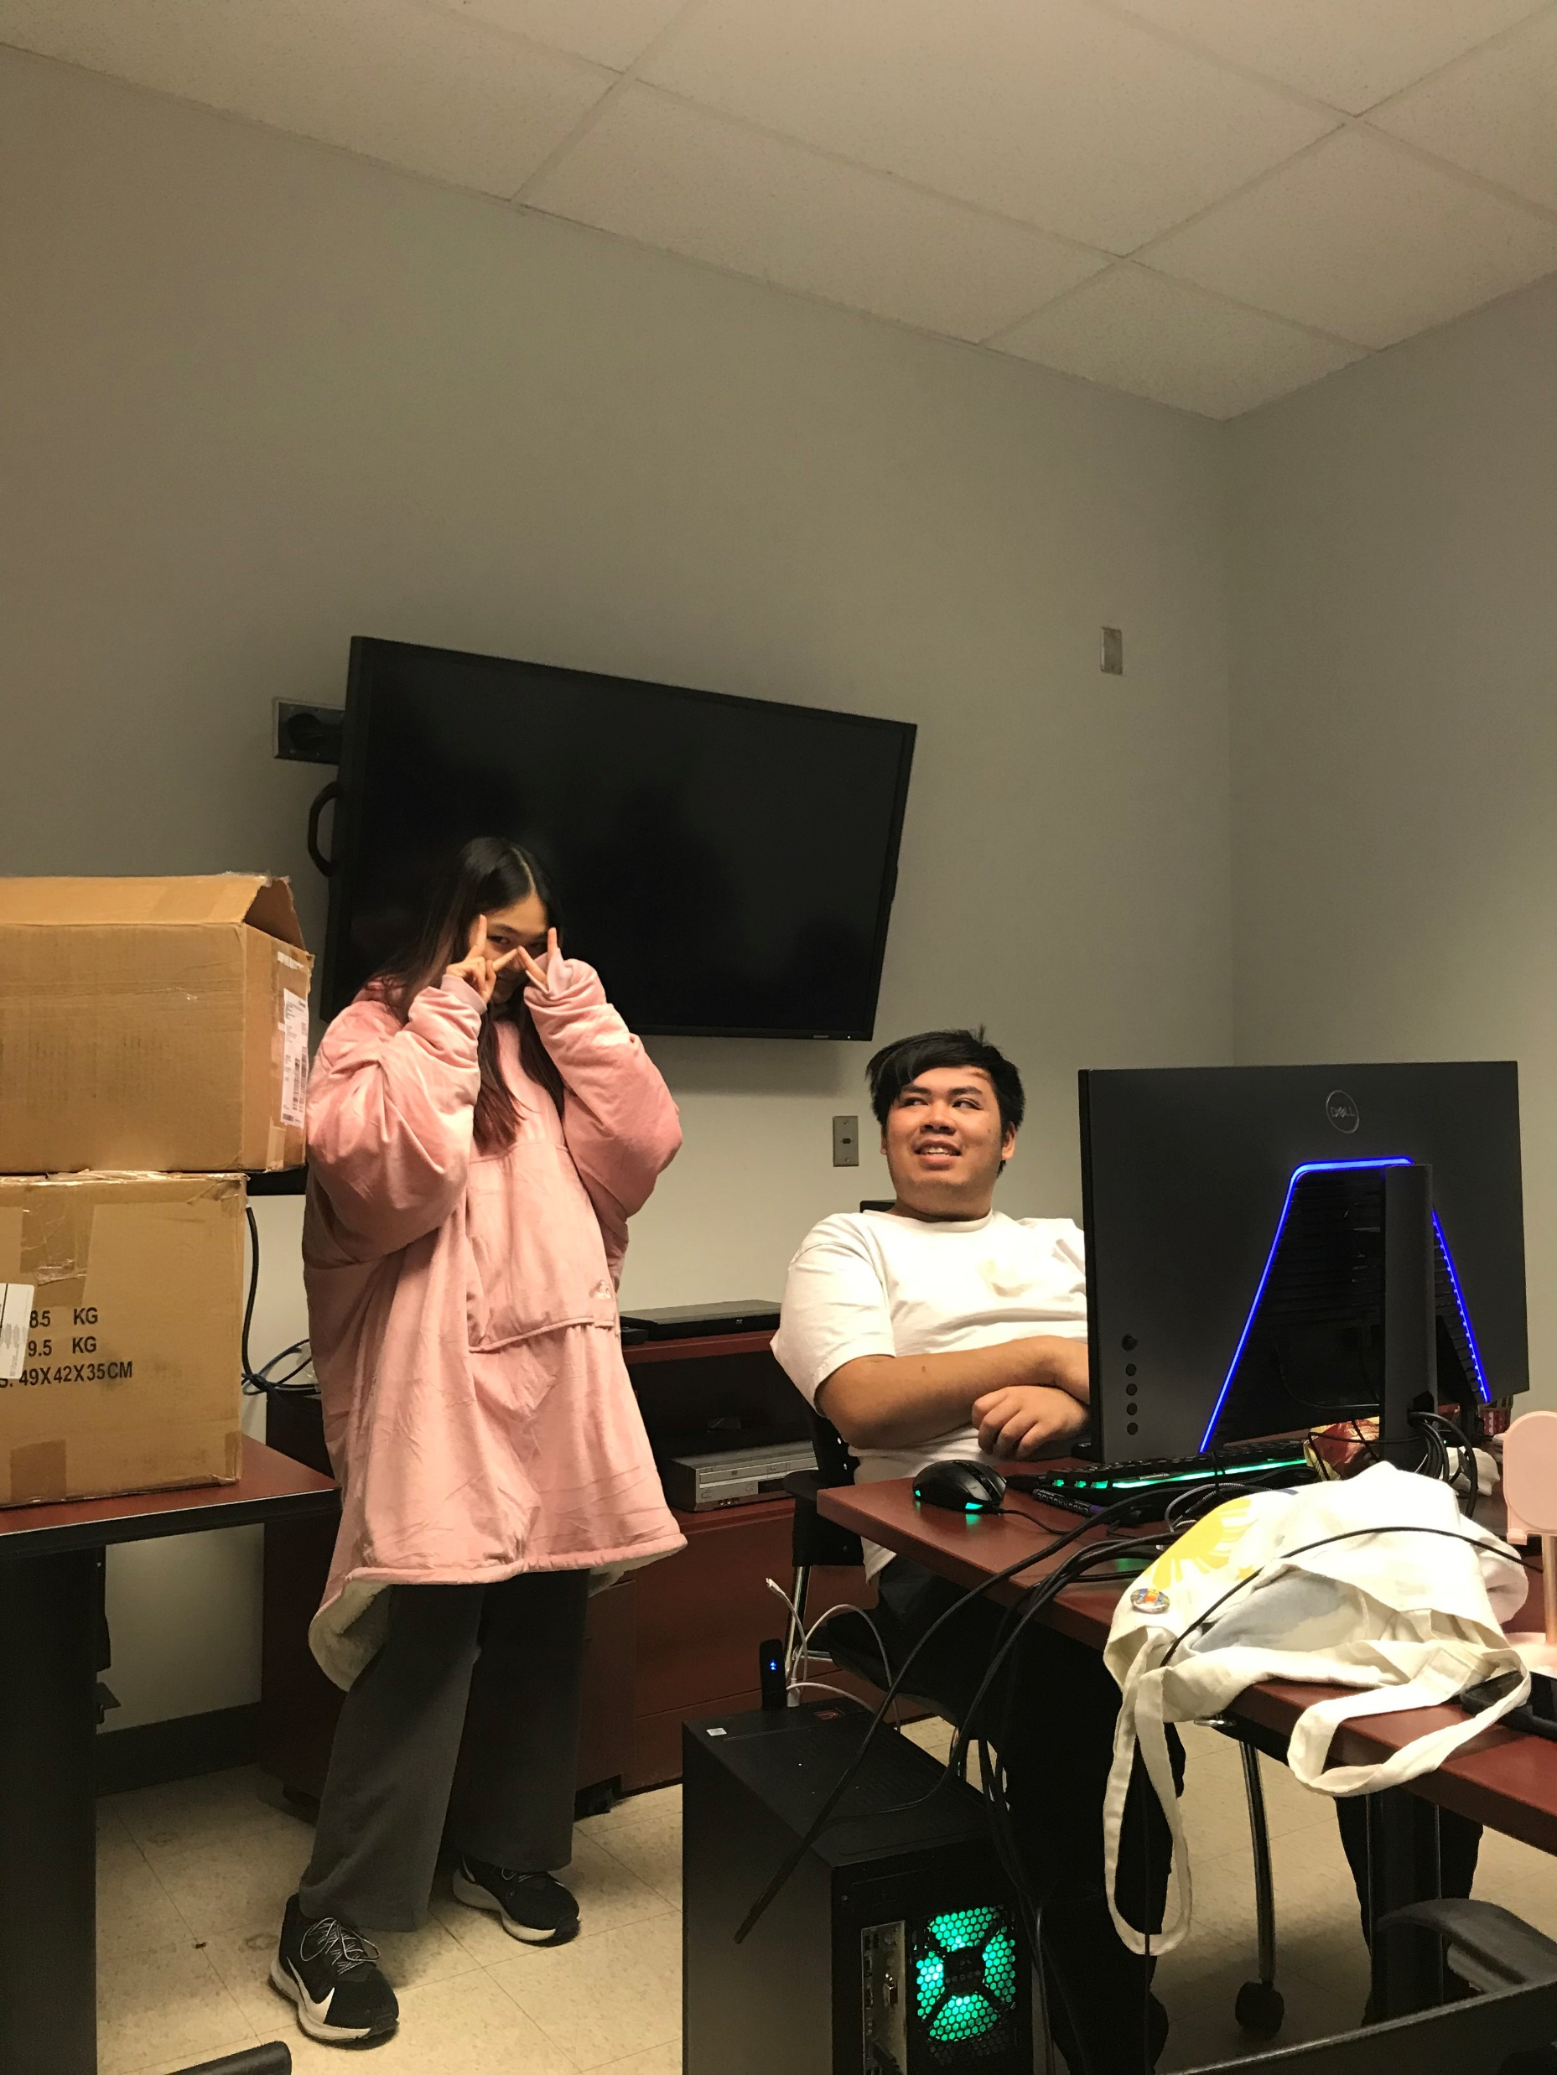
Made with love by:
Isham Jillian Kha Lyka Laura Minh
and Sarah

